Slide 1
Deep learning for image Analytics; Convolutional Neural Networks
IMT 575
Bill Howe

Slide 2
Today
Introduction (10 min)
Q&A Module and Lab (any of DL, Text, Image) (20 min)
Reading Response (15 min) (5 min)
Architecture Design (15 min) (5 min)
Discussion (20 min) (40 min)
Deep Learning Programming Frameworks (Tensorflow, PyTorch, etc.)
CNN Example by Code for Image Classification
Learning Objective: What is a “Convolutional Layer” and why do we use it?
Learning Objective: What is a “Max Pooling Layer” and why do we use it?

Slide 3
Tensorflow, PyTorch, and all that:
What is the point of deep learning frameworks?
Easily build big computational graphs
Easily compute gradients in computational graphs
Run it all efficiently on GPU
src: Fei-Fei Li & Justin Johnson & Serena Yeung L, Stanford

Slide 4
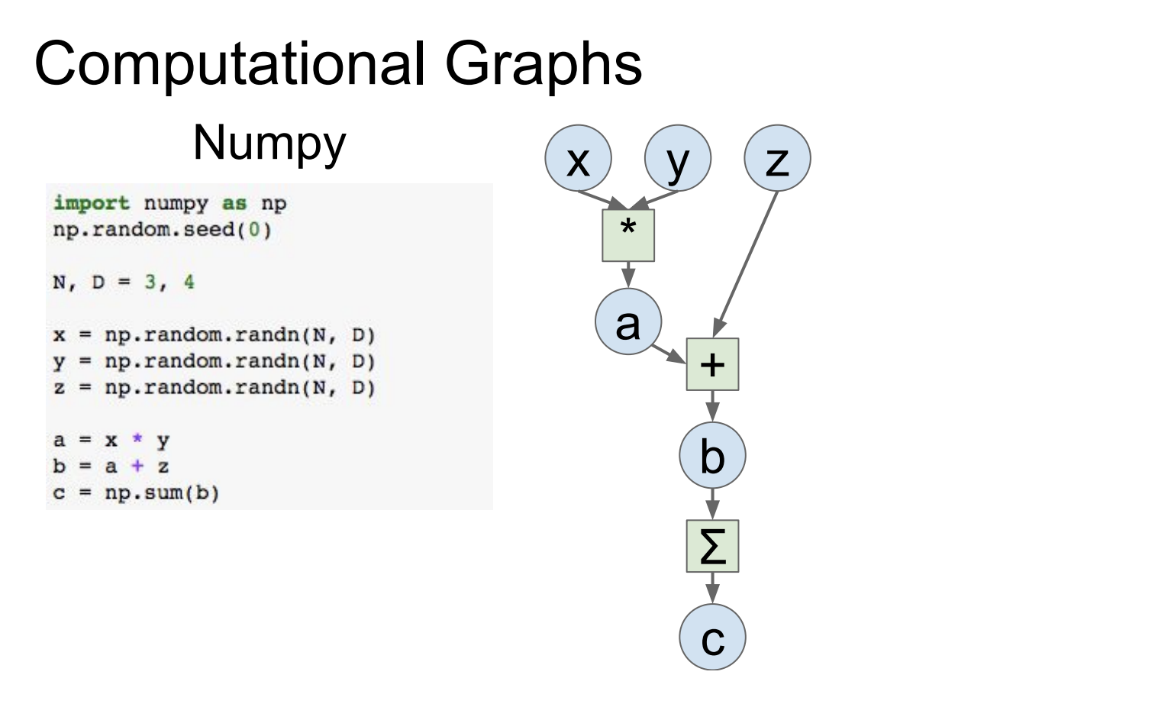
src: Fei-Fei Li & Justin Johnson & Serena Yeung L, Stanford

Slide 5
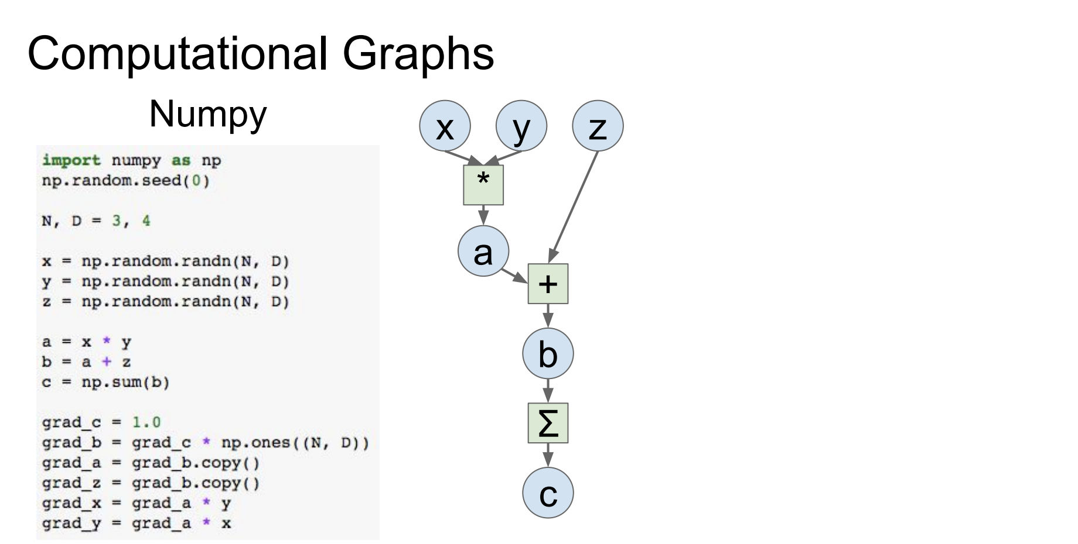
src: Fei-Fei Li & Justin Johnson & Serena Yeung L, Stanford

Slide 6
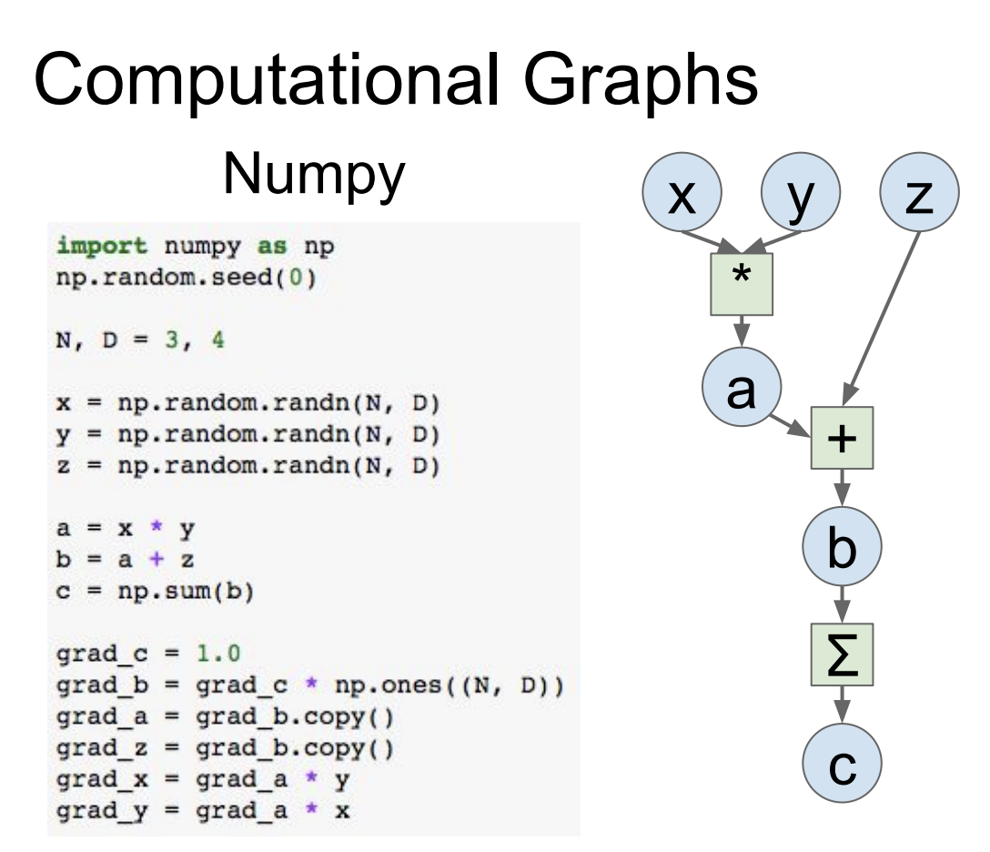
Problems:
You must compute your own gradient
Can’t run on a GPU
src: Fei-Fei Li & Justin Johnson & Serena Yeung L, Stanford

Slide 7
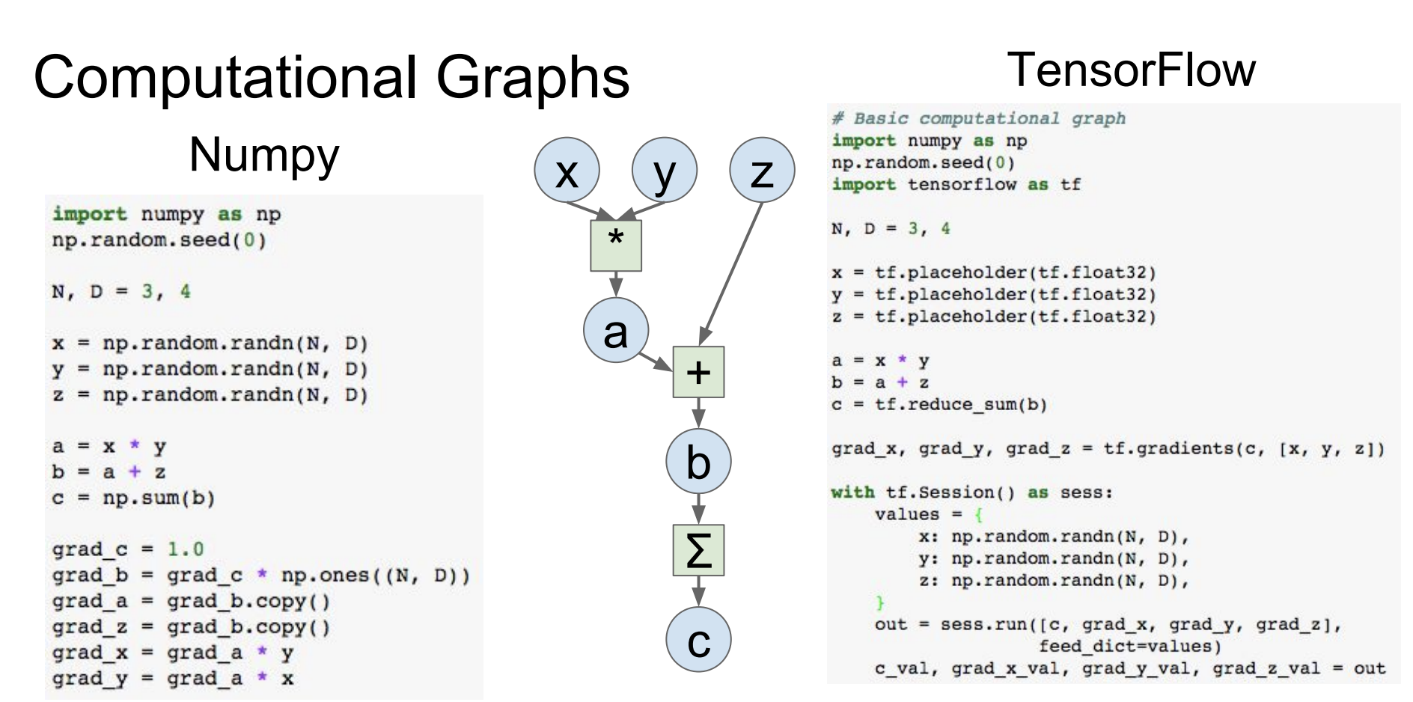
Construct the graph
Compute the gradients
src: Fei-Fei Li & Justin Johnson & Serena Yeung L, Stanford

Slide 8
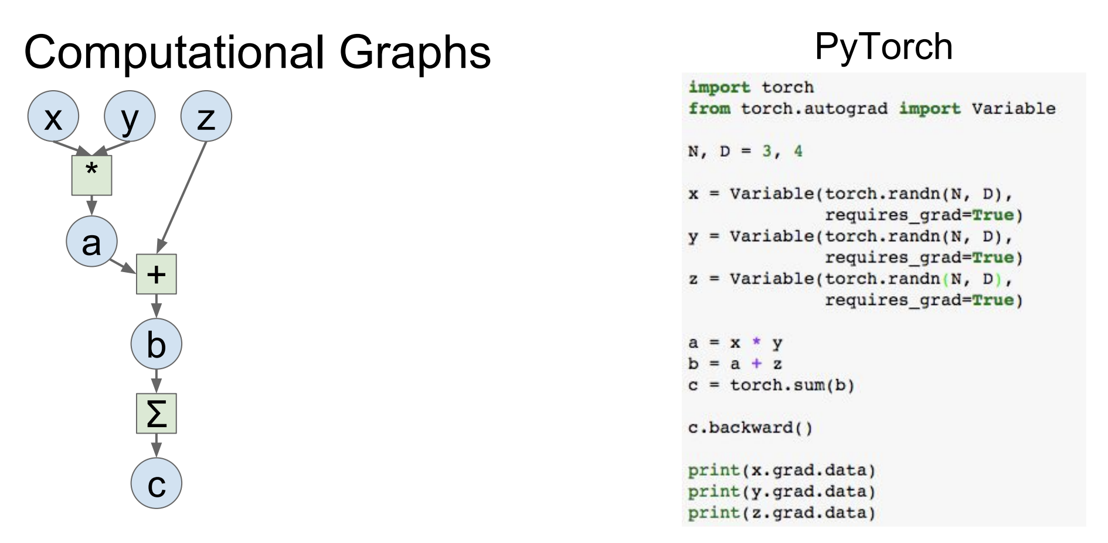
Define variables
Graph looks like numpy
Compute the gradients in one call!
src: Fei-Fei Li & Justin Johnson & Serena Yeung L, Stanford

Slide 9
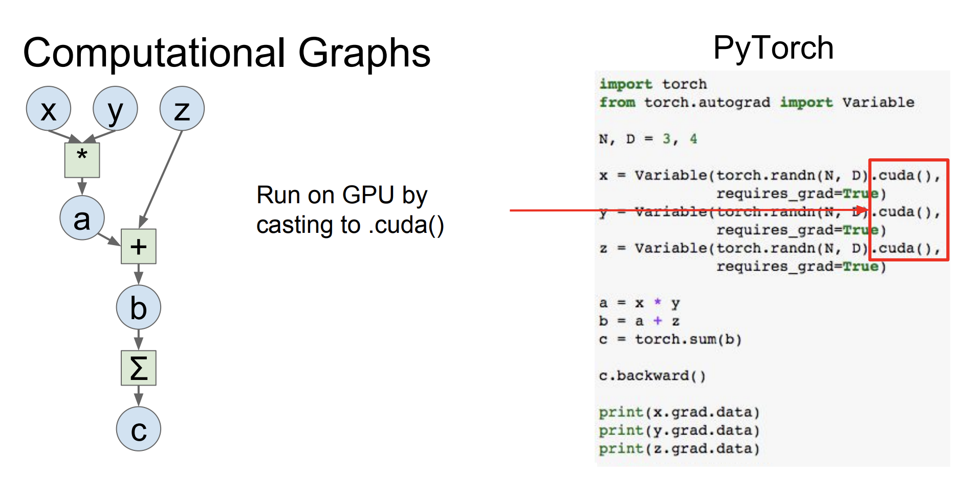
src: Fei-Fei Li & Justin Johnson & Serena Yeung L, Stanford

Slide 10
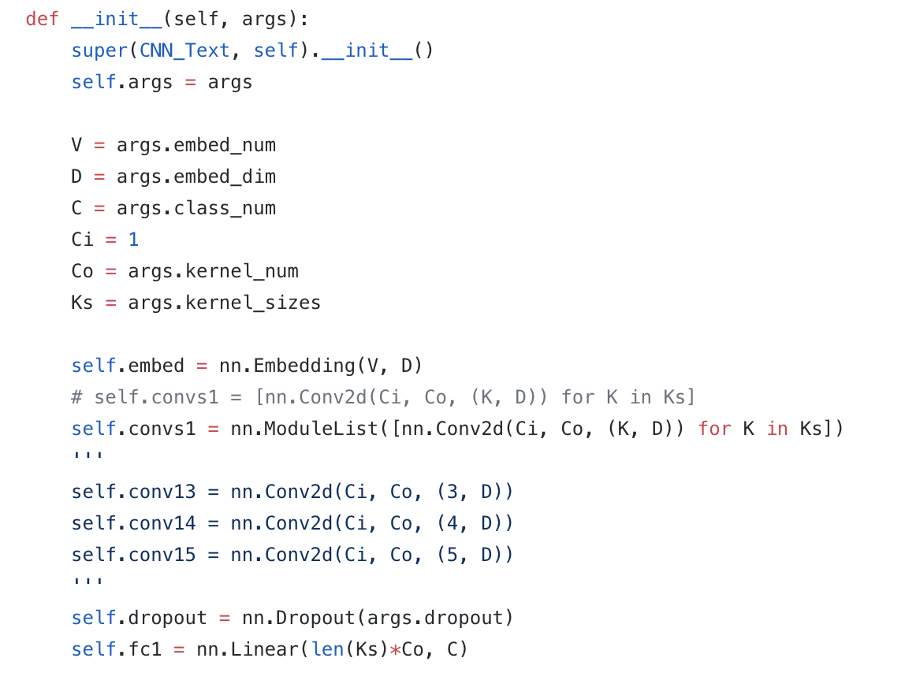
in pytorch
embedding layer
convolutional layers

Slide 11
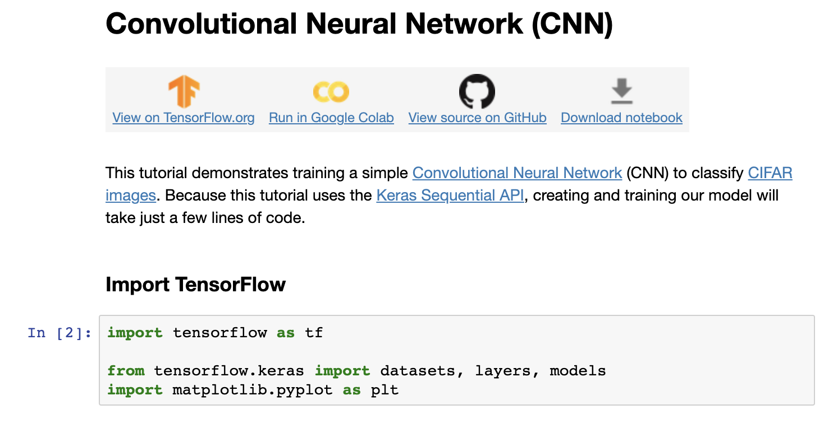
https://www.tensorflow.org/tutorials/images/cnn

Slide 12
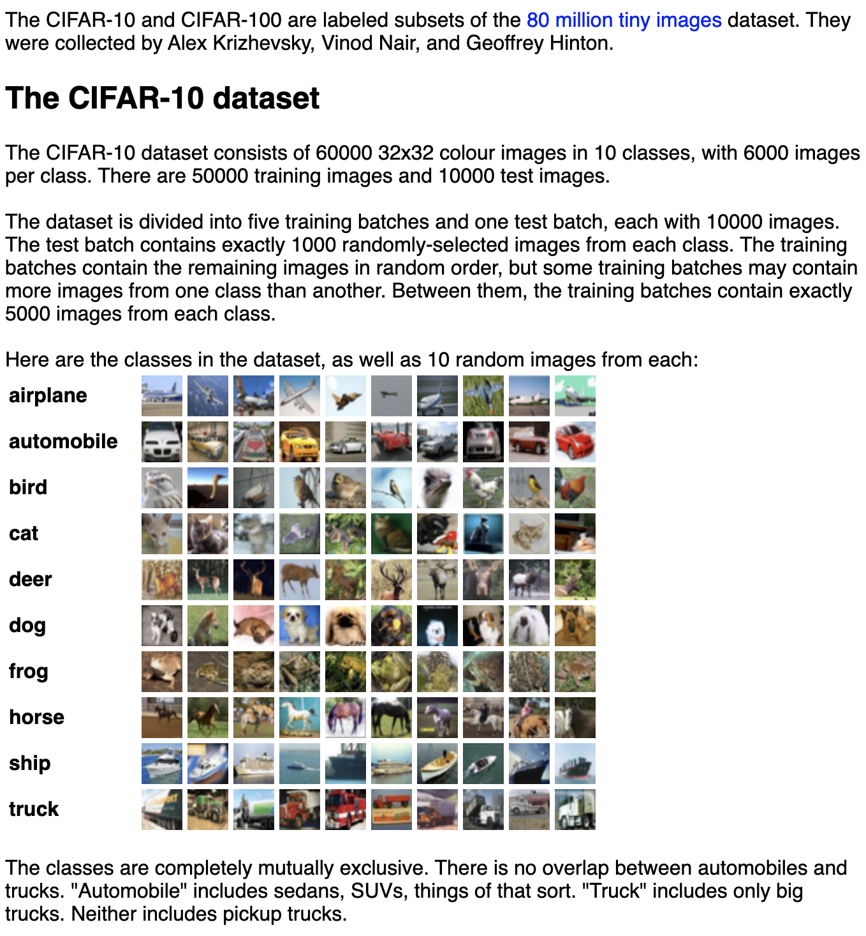

Slide 13
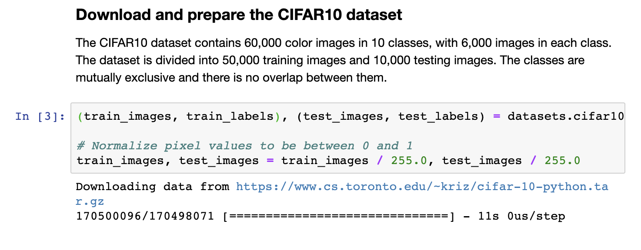
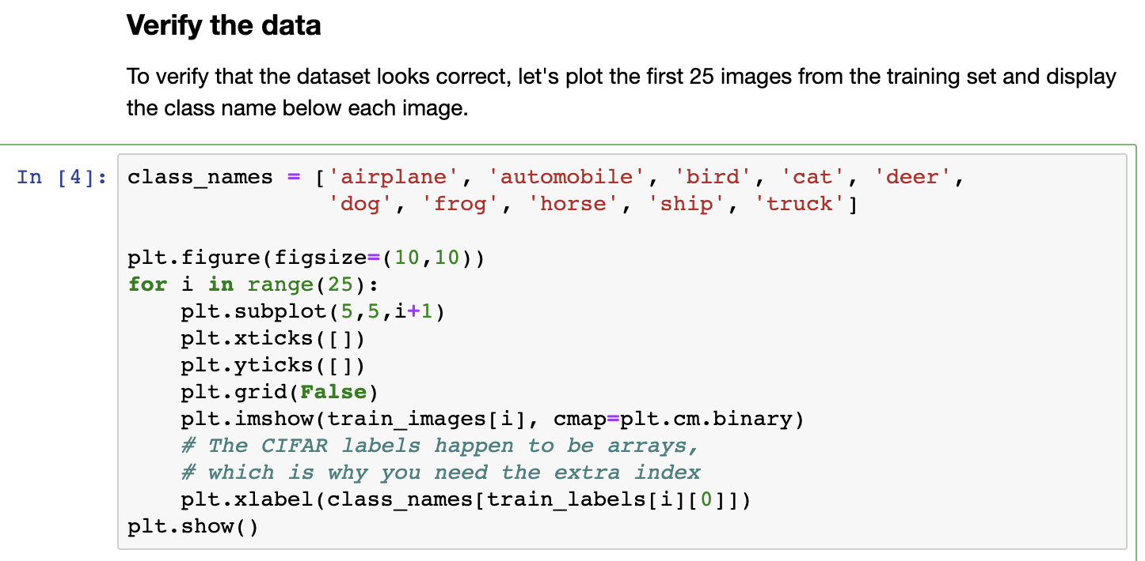

Slide 14
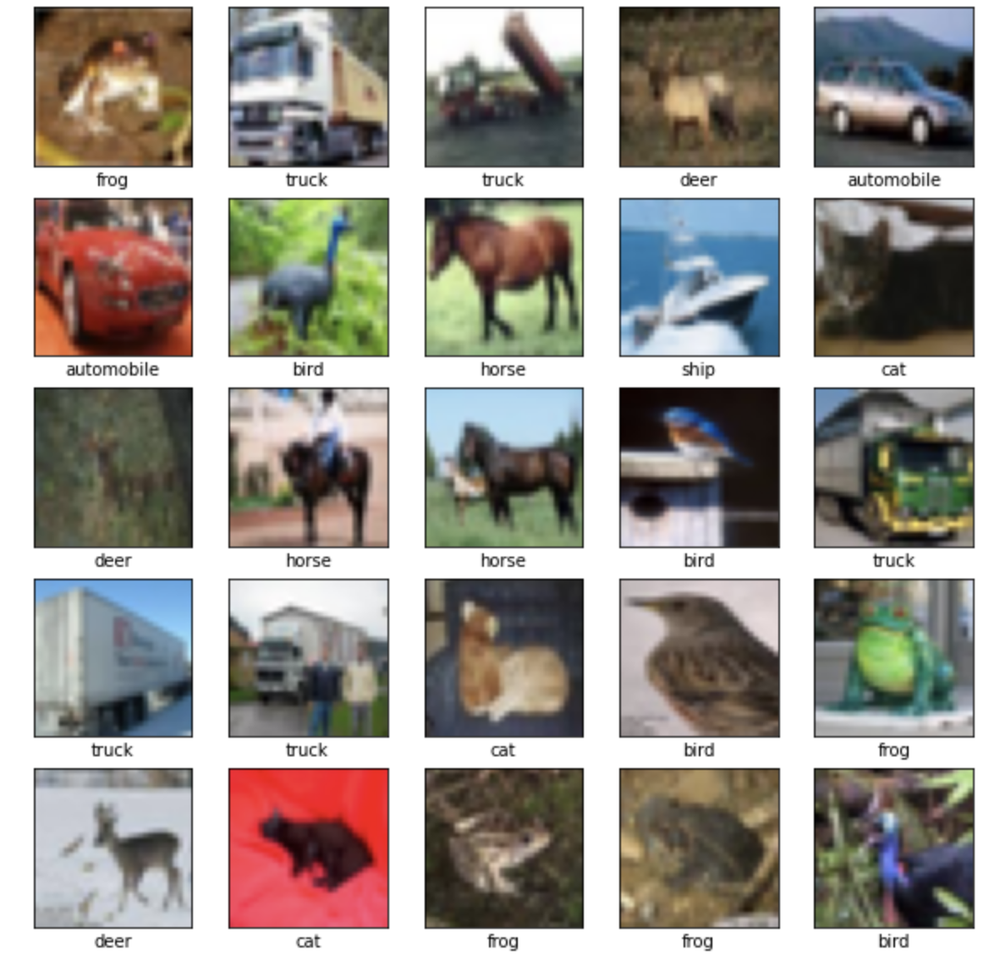

Slide 15
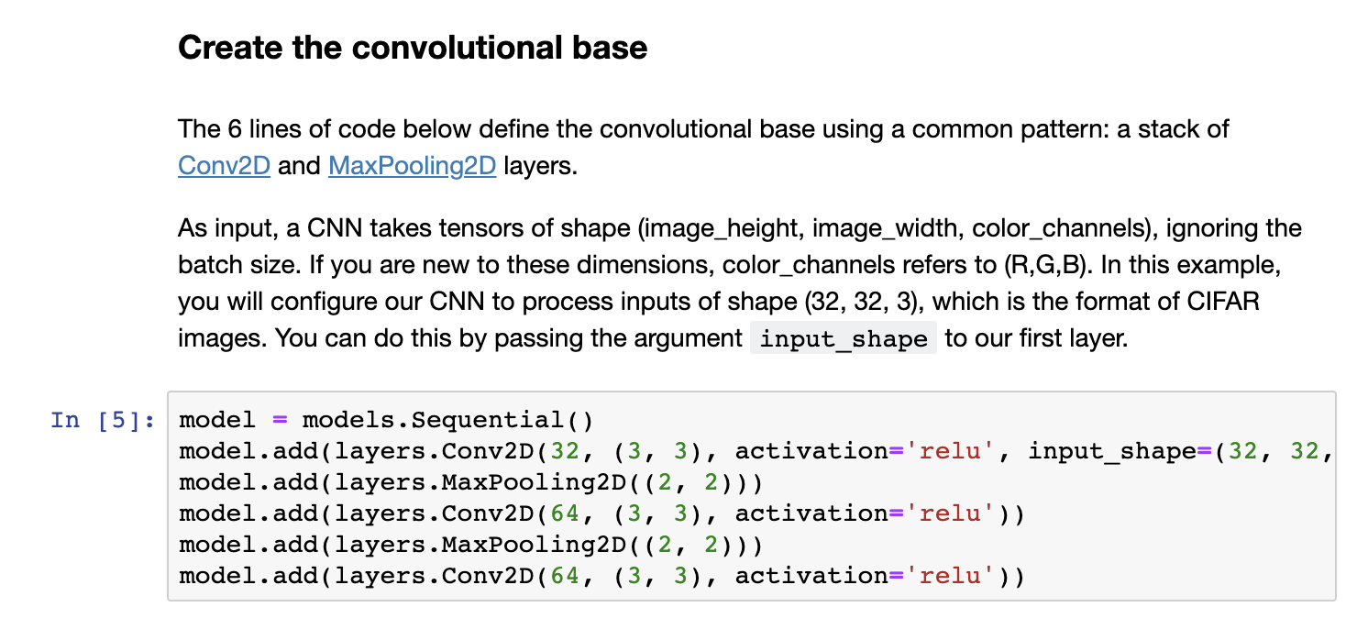
https://www.tensorflow.org/tutorials/images/cnn

Slide 16
Is the input sequential?
RNN, LSTM layers (might be spelled differently)
Images
Conv->MaxPool->Conv->MapPool
Classification
Dense (or “Embedding”)
Overfitting

Slide 17
Groups a stack of layers into a model
Convolutional Layer
Pooling Layer
Do it again

Slide 18
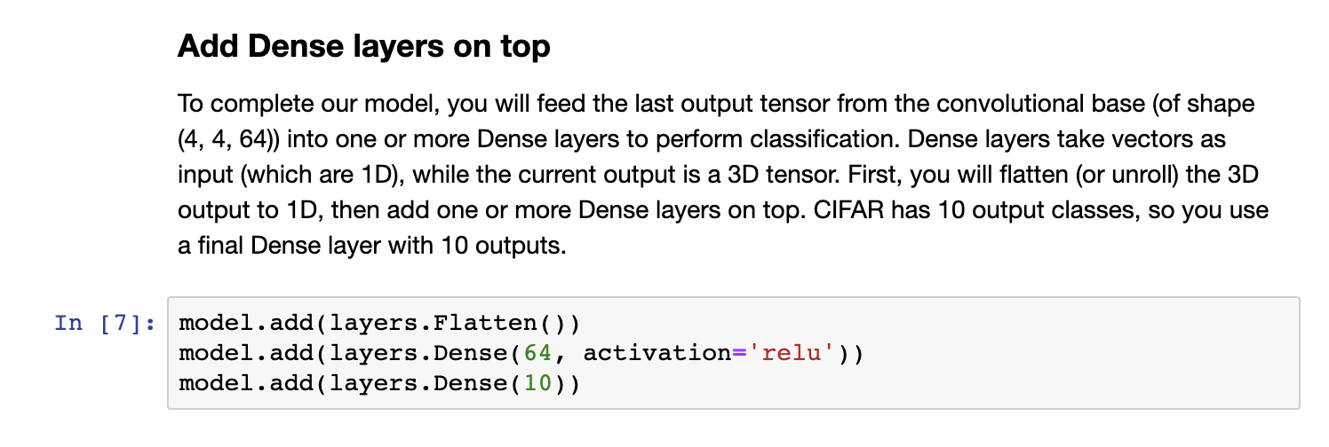
https://www.tensorflow.org/tutorials/images/cnn

Slide 19
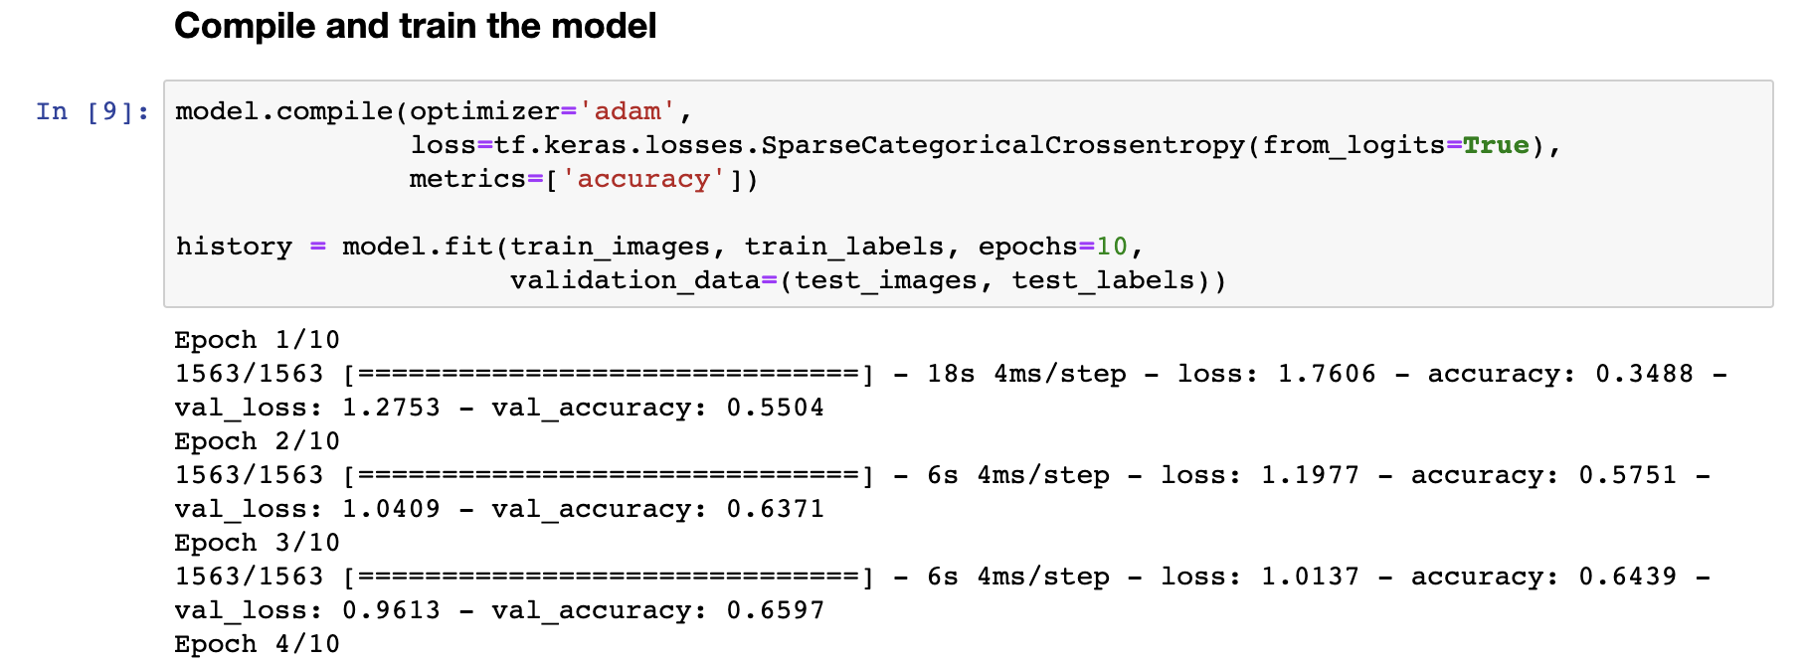
https://www.tensorflow.org/tutorials/images/cnn

Slide 20

Convolutional Layers
Dense Layers

Slide 21

Convolution Layer
filter:
1 | 0 | 1
0 | 1 | 0
1 | 0 | 1
https://devblogs.nvidia.com/parallelforall/deep-learning-nutshell-core-concepts/

Slide 22
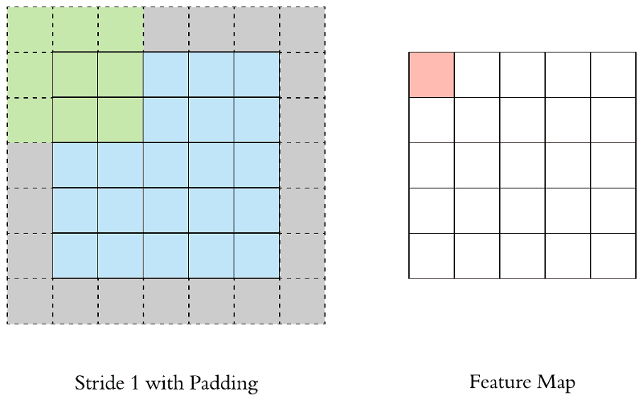
https://towardsdatascience.com/applied-deep-learning-part-4-convolutional-neural-networks-584bc134c1e2

Slide 24
Max Pooling layer

Slide 25
Why do max-pooling?
Saves space
Reduces overfitting?
Because I’m going to add more convolutions after it!
Allows the short-range convolutions to extend over larger subfields of the images
So we can spot larger objects
Eg, a long horizontal line, or a corner, or …
At some point the feature maps start to get very sparse and blobby – they are indicators of some semantic property, not a recognizable transformation of the image
Then just use them as features in a “normal” ANN

Slide 26
Convolutional Layers
Dense Layers

Slide 27
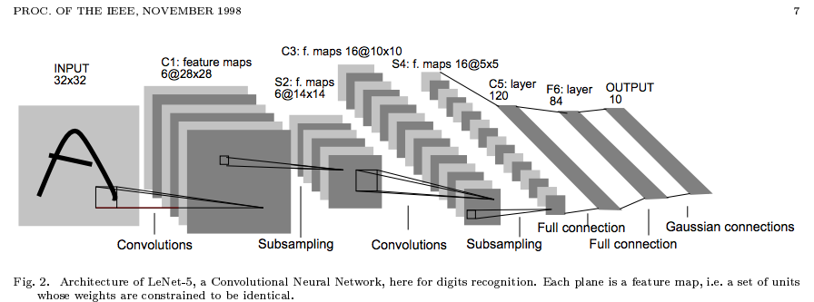

Slide 28
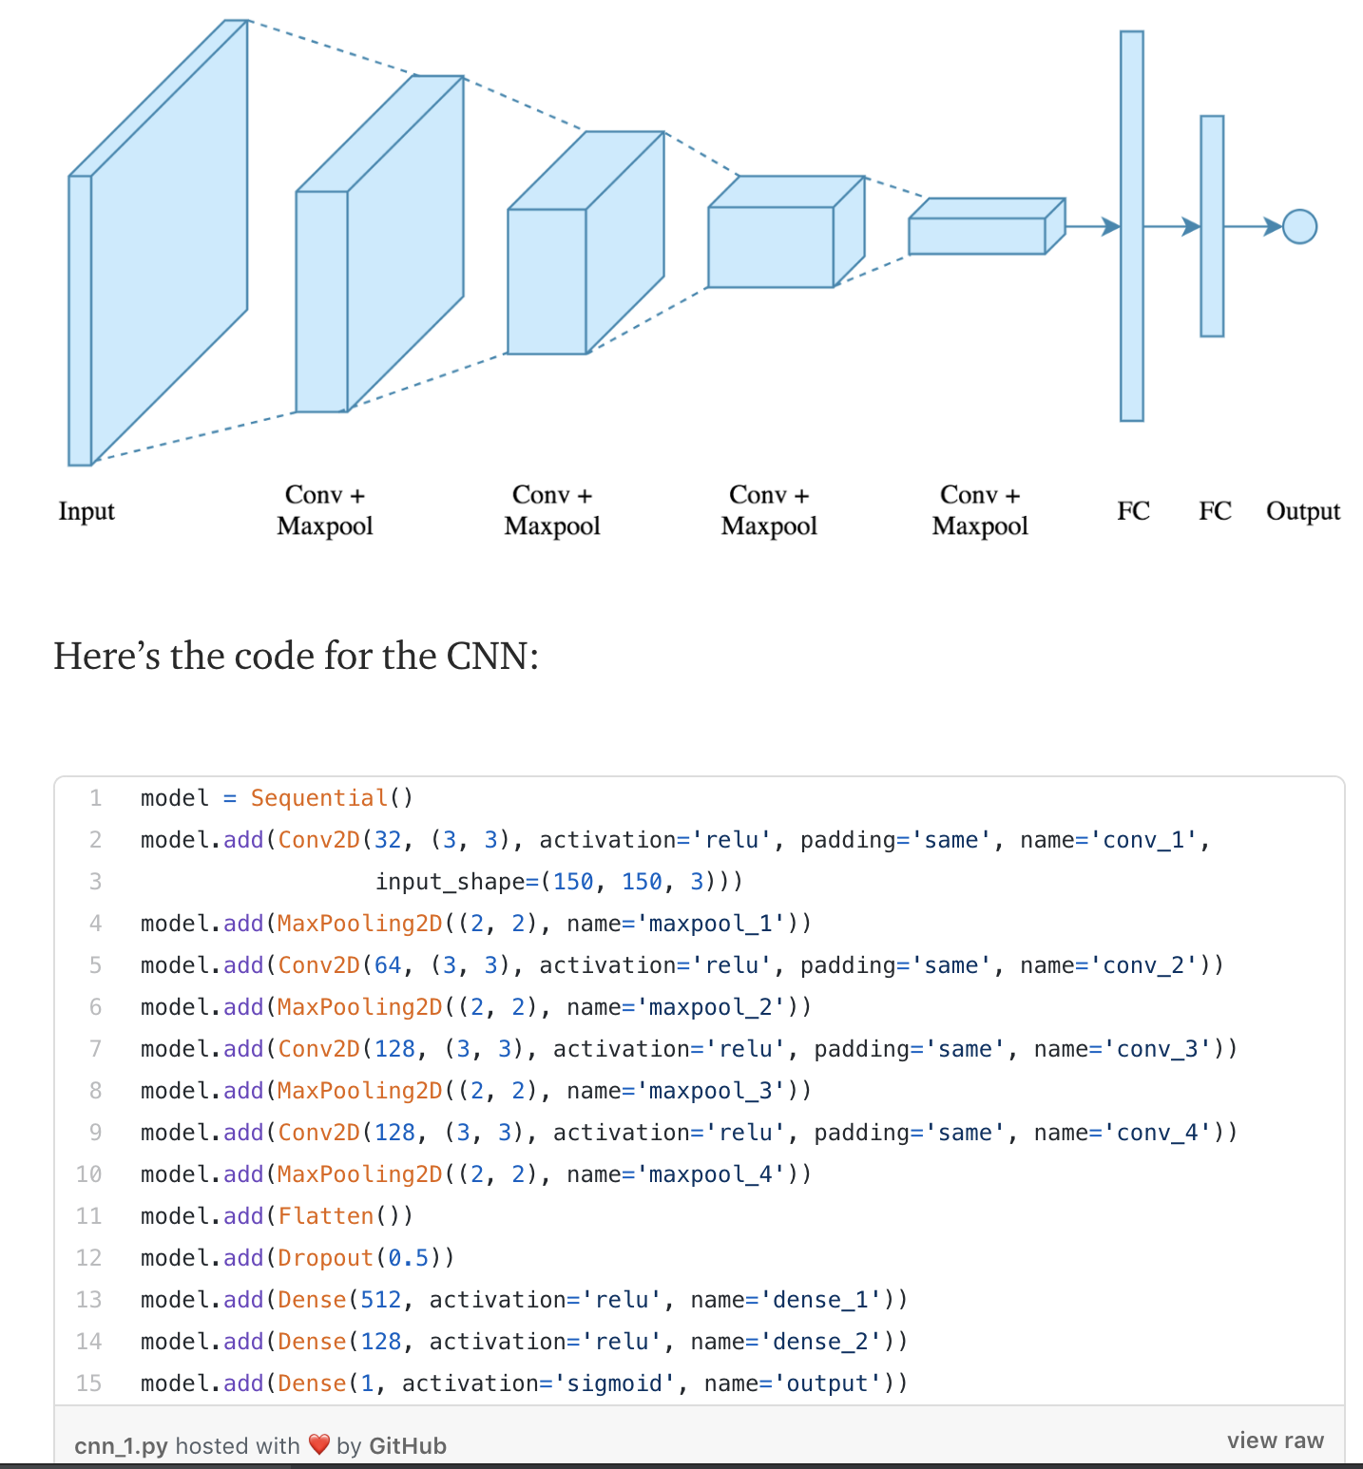

Slide 29
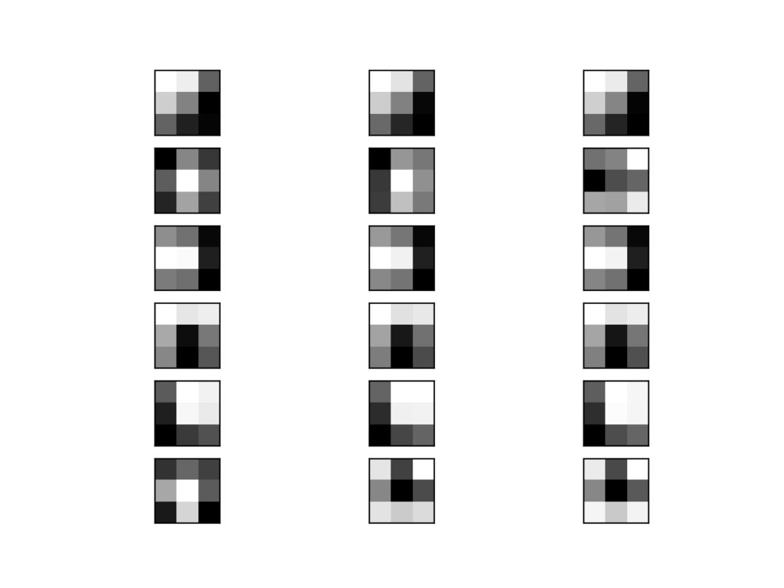
Convolutions mean applying filters to input
Where do the filters come from?

Slide 30
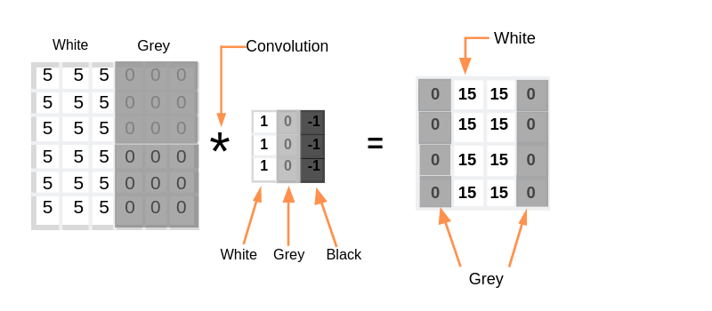

Example: A filter for edge detection

Slide 31
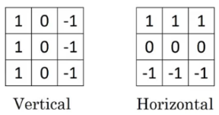
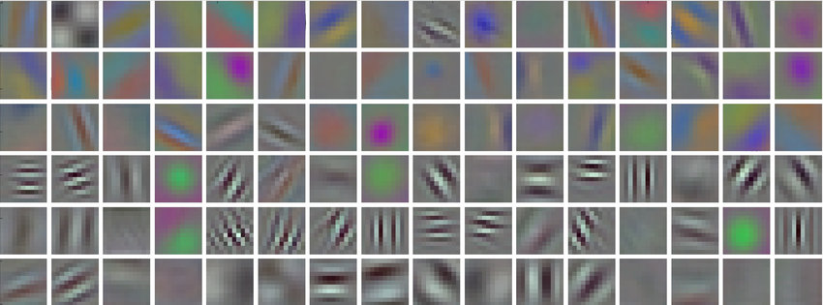
CNNs: Where do we get the filters?
We could design them
Edge detection filters
Other patterns

Slide 32
CNNs: Where do we get the filters?
In practice, start with random filters – learn which features are important (edges? Regions? Color? Etc.)

Slide 33
Example of features in each layer
https://www.cs.princeton.edu/~rajeshr/papers/icml09-ConvolutionalDeepBeliefNetworks.pdf

Slide 34
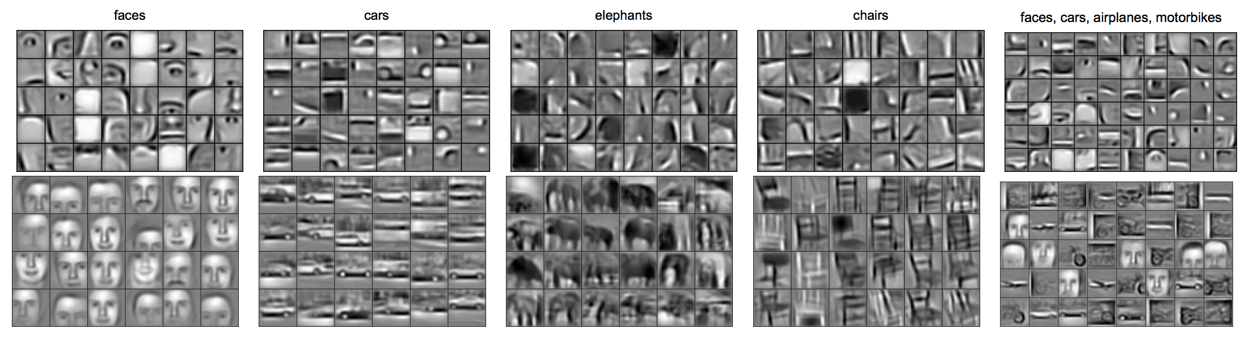
https://www.cs.princeton.edu/~rajeshr/papers/icml09-ConvolutionalDeepBeliefNetworks.pdf

Slide 35
https://www.cs.princeton.edu/~rajeshr/papers/icml09-ConvolutionalDeepBeliefNetworks.pdf

Slide 36
https://www.cs.princeton.edu/~rajeshr/papers/icml09-ConvolutionalDeepBeliefNetworks.pdf

Slide 37
https://www.cs.princeton.edu/~rajeshr/papers/icml09-ConvolutionalDeepBeliefNetworks.pdf

Slide 38
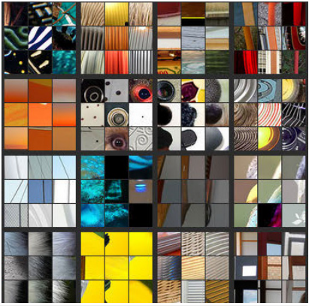
Units in Layer 3 of a CNN for object recognition
Matthew Zeiler and Rob Fergus, “Visualizing and Understanding Convolutional Networks” (ECCV 2014)

Slide 39
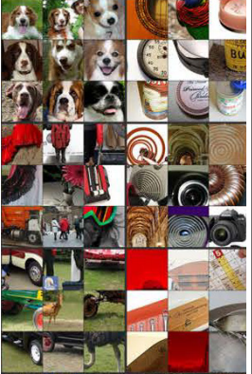
Units in Layer 4 of a CNN for object recognition
Matthew Zeiler and Rob Fergus, “Visualizing and Understanding Convolutional Networks” (ECCV 2014)

Slide 40
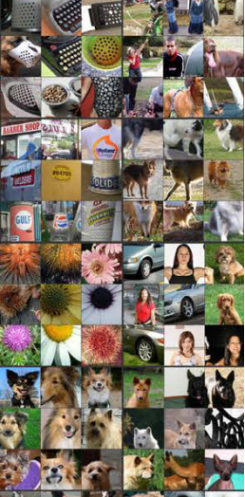
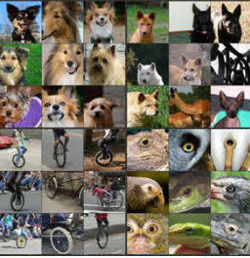
Units in Layer 5
Matthew Zeiler and Rob Fergus, “Visualizing and Understanding Convolutional Networks” (ECCV 2014)

Slide 41
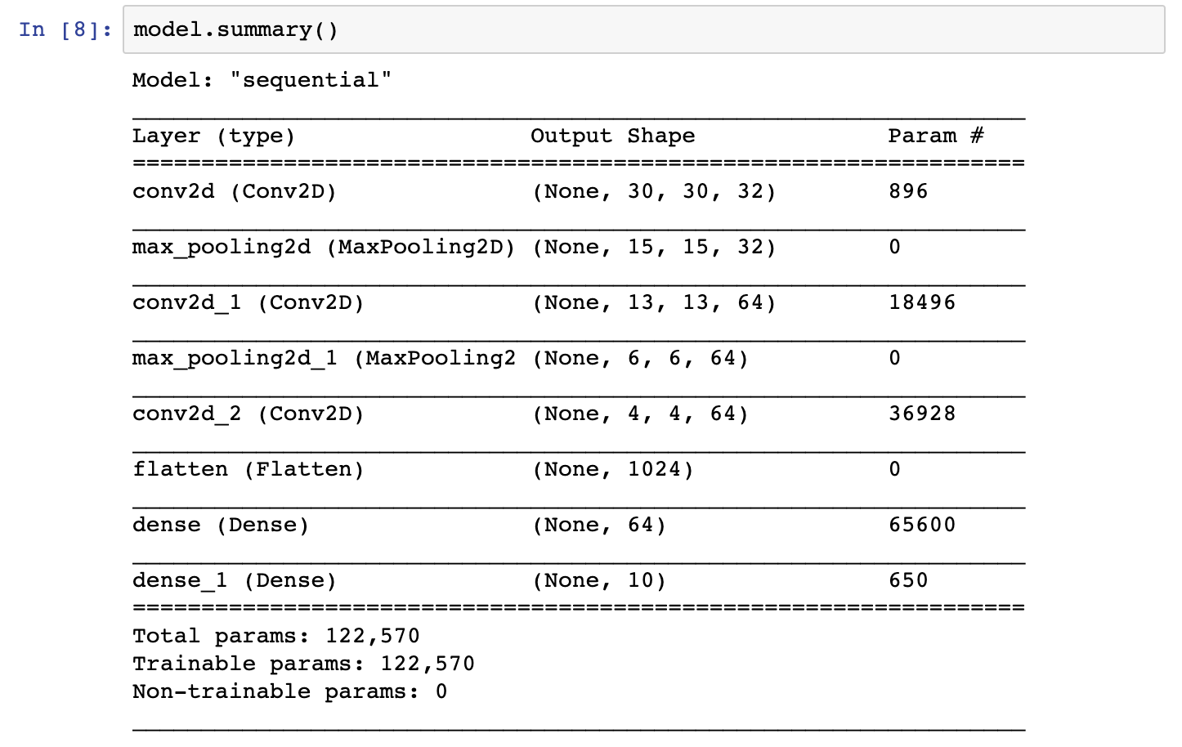

Slide 42
https://www.tensorflow.org/tutorials/images/cnn

Slide 43
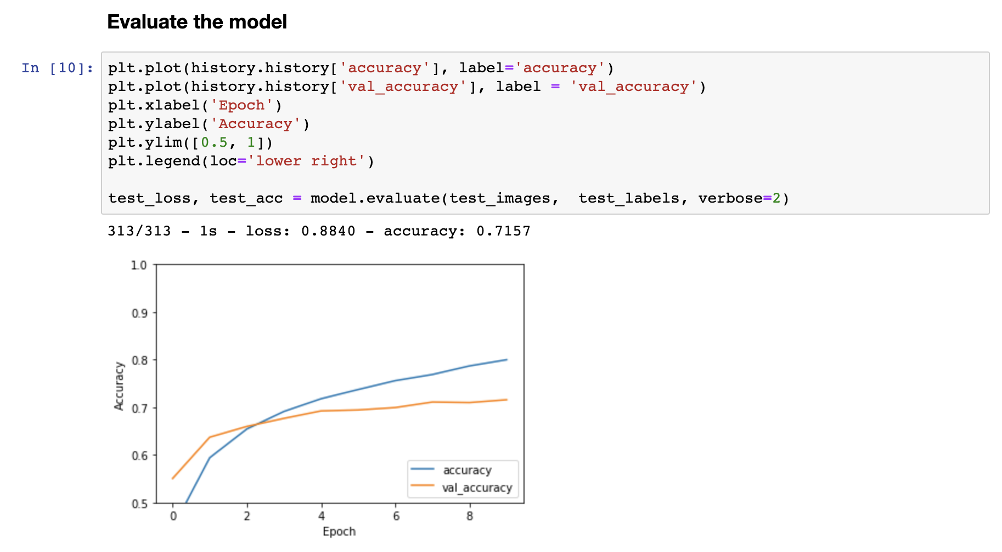
What is the difference between accuracy and val_accuracy?
https://www.tensorflow.org/tutorials/images/cnn

Slide 44
Today
CNN Example by Code for Image Classification
Learning Objective: What is a “Convolutional Layer” and why do we use it?
Learning Objective: What is a “Max Pooling Layer” and why do we use it?
Aside on Deep Learning Frameworks (Tensorflow, PyTorch, etc.)
CNN Example by Task for Face Recognition
DL Recap

Slide 45
Today
CNN Example by Code for Image Classification
Learning Objective: What is a “Convolutional Layer” and why do we use it?
Learning Objective: What is a “Max Pooling Layer” and why do we use it?
Aside on Deep Learning Frameworks (Tensorflow, PyTorch, etc.)
Return Face Recognition
DL Recap

Slide 46
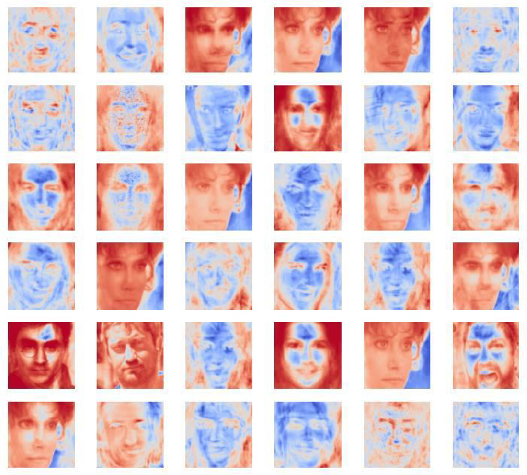
Understanding How Neural Networks See

Slide 47
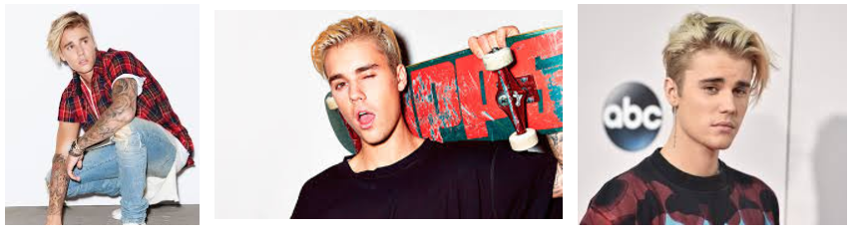
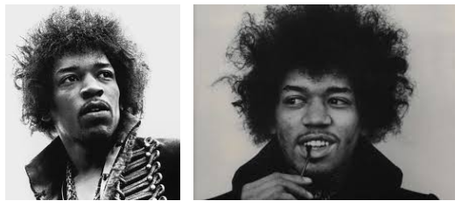
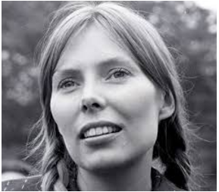
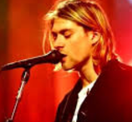
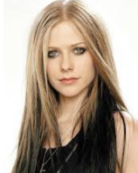
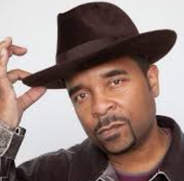
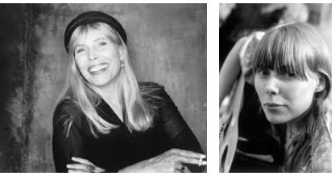
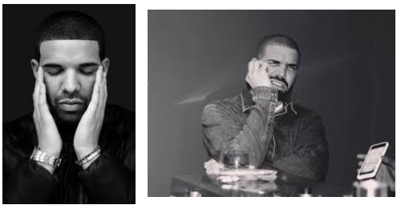
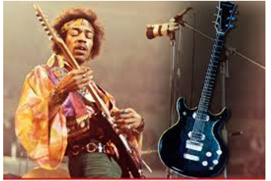
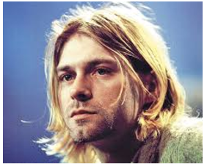
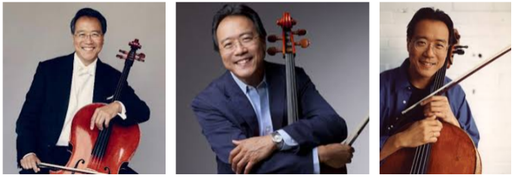
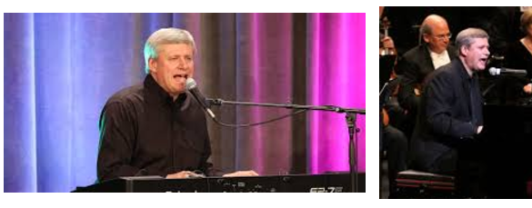
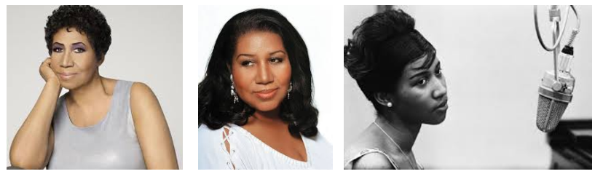
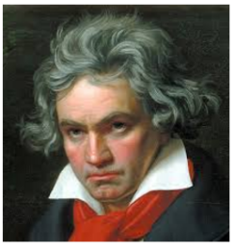
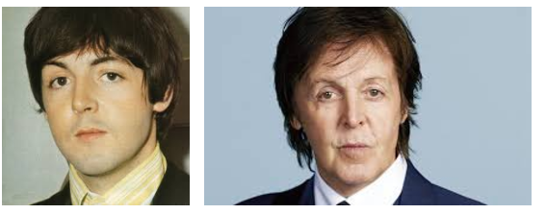
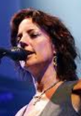
Example: Recognizing Faces

Slide 48
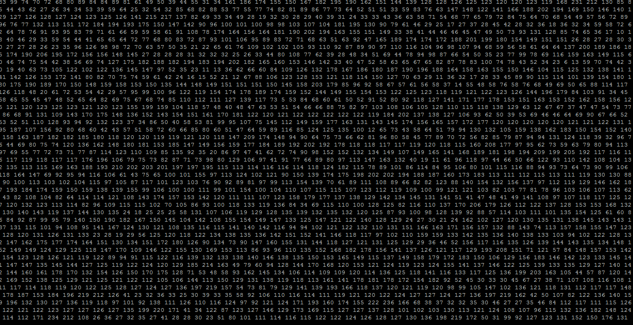
What a celebrity looks like to a computer

Slide 49
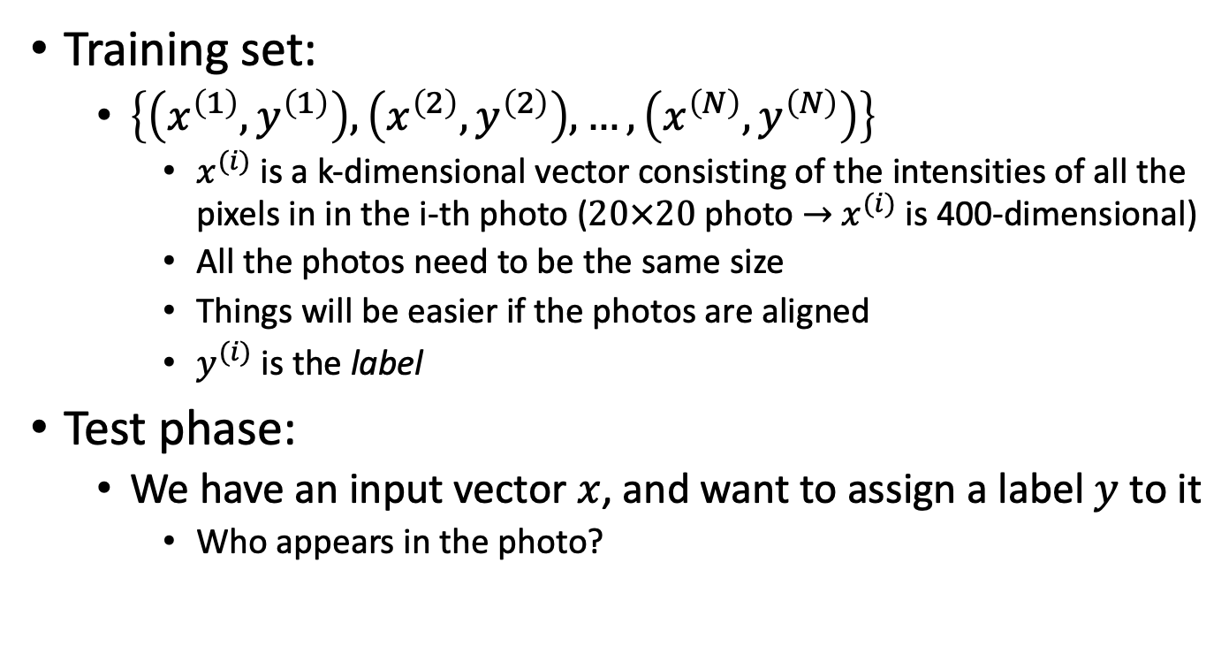
The Face Recognition Task
Training set:
$\left\{\left(x^{\left(1\right)}, y^{\left(1\right)}\right),\left(x^{\left(2\right)}, y^{\left(2\right)}\right), …,\left(x^{\left(N\right)}, y^{\left(N\right)}\right)\right\}$
$x^{(i)}$ is a k-dimensional vector consisting of the intensities of all the pixels in in the i-th photo ($20×20$ photo $→$ $x^{(i)}$ is 400-dimensional)
All the photos need to be the same size
Things will be easier if the photos are aligned
$y^{(i)}$ is the label
Test phase:
We have an input vector $x$, and want to assign a label $y$ to it
Who appears in the photo?

Slide 50

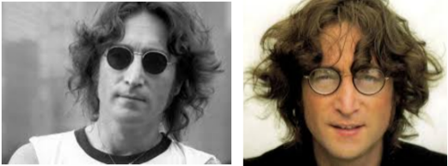
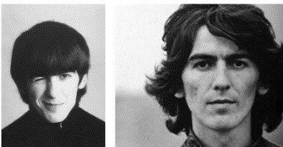




First Attempt: 1-Nearest Neighbor
Training set: $\left\{\left(x^{\left(1\right)}, y^{\left(1\right)}\right),\left(x^{\left(2\right)}, y^{\left(2\right)}\right), …,\left(x^{\left(N\right)}, y^{\left(N\right)}\right)\right\}$
Input: $x$
1-Nearest Neighbor algorithm:
Find the training photo/vector $x^{(i)}$ that’s as close as possible to $x$, and output the label $y^{(i)}$
Output: Paul
Closest training image to the input $x$

Slide 51

What do we need to make this work?
What assumptions about the image data must hold?
All images must be of the same size
If they aren’t, scale/crop them – this can be tricky
It must be the case that if two datapoints (images) $x^{(0)}$ and $x^{(1)}$ are similar in content, $|x^{\left(0\right)}⋅x^{\left(1\right)}|$ is large
When might this not be the case?
The images need to be co-registered (i.e., eyes, mouth, nose, etc. are all always found in the same coordinates, no matter the image)

Slide 52














2nd attempt: A Simple Neural Network for Face Recognition
$z_{k}$ is the weight associated with the kth actor name
Why this function?
$$z_{k}=σ\left(\sum_{j=1}^{4096}{W^{\left(1, j, k\right)}}x_{j}+b^{\left(1, k\right)}\right)=σ\left(W^{\left(1, ∗, k\right)}⋅x+b^{\left(1, k\right)}\right)$$
$$σ(x)$$
$$x$$
$$b^{(1,3)}$$
$$z_{3}$$
$$z_{6}$$
$$b^{(1,1)}$$
$$z_{1}$$
…
…
outputs (one per actor)
$$W^{(1, 1, 1)}$$
$$W^{(1,4096, 6)}$$
$$x_{1}$$
…
$$x_{20}$$
…
…
…
…
…
…
…
…
$$x_{4096}$$
input vector (flattened 64x64 image)

Slide 53











Training a neural network
Adjust the W’s ($4096×6$ coefs) and b’s (6 coefs)
Try to make it so that if $x$ is an image of actor 1, $z$ is as close as possible to (1, 0, 0, 0, 0, 0) $x$ is an image of actor 2, $z$ is as close as possible to (0, 1, 0, 0, 0, 0) ……
$$b^{(1,3)}$$
$$z_{3}$$
$$z_{6}$$
$$b^{(1,1)}$$
$$z_{1}$$
…
…
outputs (one per actor)
$$z_{k}=σ\left(\sum_{j=1}^{4096}{W^{\left(1, j, k\right)}}x_{j}+b^{\left(1, k\right)}\right)=σ\left(W^{\left(1, ∗, k\right)}⋅x+b^{\left(1, k\right)}\right)$$
$$W^{(1, 1, 1)}$$
$$W^{(1,4096, 6)}$$
$$x_{1}$$
…
$$x_{20}$$
…
…
…
…
…
…
…
…
$$x_{4096}$$
input vector (flattened 64x64 image)

Slide 54

Face recognition
Compute the z for a new image x
If $z_{k}$ is the largest output, output name k
$$b^{(1,3)}$$
$$z_{3}$$
$$z_{6}$$
$$b^{(1,1)}$$
$$z_{1}$$
…
…
outputs (one per actor)
$$z_{k}=σ\left(\sum_{j=1}^{4096}{W^{\left(1, j, k\right)}}x_{j}+b^{\left(1, k\right)}\right)=σ\left(W^{\left(1, ∗, k\right)}⋅x+b^{\left(1, k\right)}\right)$$
$$W^{(1, 1, 1)}$$
$$W^{(1,4096, 6)}$$
$$x_{1}$$
$$x_{20}$$
…
…
…
…
input vector (flattened 64x64 image)
…
…
…
…
…
$$x_{4096}$$
54

Slide 55

An interpretation
$z_{1}$ is large if $W^{\left(1, ∗, 1\right)}⋅x$ is large $z_{2}$ is large if $W^{\left(1, ∗, 2\right)}⋅x$ is large
….
$W^{\left(1, ∗, 1\right)}$, $W^{\left(1, ∗, 2\right)}$, …, $W^{\left(1, ∗, 6\right)}$ are templates for the faces of actor 1, actor 2, …, actor 6
$$b^{(1,3)}$$
$$z_{3}$$
$$z_{6}$$
$$b^{(1,1)}$$
$$z_{1}$$
…
…
outputs (one per actor)
$$z_{k}=σ\left(\sum_{j=1}^{4096}{W^{\left(1, j, k\right)}}x_{j}+b^{\left(1, k\right)}\right)=σ\left(W^{\left(1, ∗, k\right)}⋅x+b^{\left(1, k\right)}\right)$$
$$W^{(1, 1, 1)}$$
$$W^{(1,4096, 6)}$$
$$x_{1}$$
$$x_{20}$$
…
…
…
…
input vector (flattened 64x64 image)
…
…
…
…
…
$$x_{4096}$$
55
55

Slide 56













Visualizing “Face templates”
Baldwin$W^{(1, ∗, 1)}$
Carrel
$$W^{(1, ∗, 2)}$$
Hader
$$W^{(1, ∗, 3)}$$
Ferrera
$$W^{(1, ∗, 4)}$$
Drescher
$$W^{(1, ∗, 5)}$$
Chenoweth
$$W^{(1, ∗, 6)}$$

Slide 57
















Introducing a hidden layer
$$b^{(2,4)}$$
$$z_{1}$$
…
$$z_{4}$$
…
$$z_{6}$$
outputs (one per actor)
$$W^{(2, 1, 1)}$$
$$W^{(2, K, 4)}$$
$$b^{(1,3)}$$
$$b^{(1,1)}$$
$$h_{1}$$
…
$$h_{3}$$
…
…
…
$$h_{K}$$
K hidden units
$$h_{k}=σ\left(W^{\left(1, ∗, k\right)}⋅x+b^{\left(1, k\right)}\right)$$
$$z_{m}=σ(W^{\left(2, ∗, m\right)}⋅h+b^{\left(2, m\right)})$$
$$W^{(1, 1, 1)}$$
$$W^{(1,4096, 6)}$$
$$x_{1}$$
…
$$x_{20}$$
…
…
…
…
…
…
…
…
$$x_{4096}$$
input vector (flattened 64x64 image)

Slide 58


Why a hidden layer?
Instead of checking whether $x$ looks like one of 6 templates, we’ll be checking whether $x$ looks like one of K templates, for a large $K$
If template $k$ (i.e., $W^{(1, ∗, k)}$) looks like actor 6, $W^{(2, k,6) }$will be large

Slide 59

Recap: face recognition for 6 actors
1-Nearest-Neighbor: match $x$ to all the images in the training set
0-hidden-layer neural network*: match $x$ to 6 templates, with one template per actor
The templates work better than any individual photo
1-hidden-layer neural network: match $x$ to $K$ templates
The templates work better than any individual photo
More templates means better accuracy on the training set
More prone to overfitting
*A.K.A. multinomial logistic regression to its friends

Slide 60

Overfitting a one-hidden-layer ANN

Slide 61

Going beyond global templates
Global templates are inflexible
Would like to detect parts of the object in different parts of the image, then “collect” them into detections of eyes, then “collect” detections of eyes into detections of different kinds of faces

Slide 62

A Deep Network
Michael Nielsen
Notes:
This is looking complex. Let’s take a step back and look at which each neuron is doing

Slide 63
Deep Neural Networks as a Model of Computation
Most people’s first instinct for classifying faces is to write a complicated computer program
A deep neural network is a computer program:
h1 = f1(x)
h2 = f2(h1)
h3 = f3(h2)
…
h9 = f8(h8)
Can think of every layer of a neural network as one step of a parallel computation
Features are the functions that are applied to the previous layers
Learning features ⬄ Learning what function to apply at step t of the algorithm

Slide 64

Deep Neural Networks
Can perform a wide range of computation
Can be learned automatically
(using gradient descent)
Powerful but not (computer) learnable: Python
Can’t make a learning algorithm that takes lots of inputs and outputs and produces Python code that generates the outputs on new inputs
Learnable but not powerful:
Logistic regression
Deep Neural Networks that aren’t deep enough
From Ilya Sutskever

Slide 65
The Deep Learning Hypothesis
Human perception is fast
(Human) neurons fire at most 100 times a second
Humans can solve simple perceptual tasks in 0.1 seconds
So out neurons fire in a sequence of 10 times at most
Success stories:
Classifying images of objects
Classifying Go positions as good or bad
Anything a human can do in 0.1 seconds, a big 10- layer neural network can do, too!

Slide 66
Problems with Supervised Networks
Early layers of the network are not trained well
Diffusion of Gradient – error attenuates as it propagates to earlier layers
Leads to very slow training
Exacerbated since last few layers can usually learn any task "pretty well" and thus the error to earlier layers drops quickly as the top layers "mostly" solve the task– lower layers never get the opportunity to use their capacity to improve results, they just do a random feature map
Need a way for early layers to do effective work
Often not enough labeled data available while lots of unlabeled data
Can we use unsupervised/semi-supervised approaches to take advantage of the unlabeled data
Deep networks tend to have more local minima problems than shallow networks during supervised training

Slide 67
Purely Supervised Learning

Slide 68
Semi-Supervised Learning

Slide 69
Greedy Layer-wise Training
Train each layer in an unsupervised way based on the input of the previous layer
How?
One way: Use an autoencoder: reproduce the input
“Stacked autoencoders”

Slide 70

Stacked autoencoder training
First train this layer

Slide 71

Stacked autoencoder training
First train this layer
Then train this layer

Slide 72

Stacked autoencoder training
First train this layer
Then train this layer
Then train this layer

Slide 73

First train this layer
Then train this layer
Then train this layer
Then train this layer
and finally this layer

Slide 74
Problem
We want to prevent the layers from just learning the identity function and learn interesting features instead
Undercomplete - middle layer smaller than input
Sparsity - penalize hidden unit activations
Use regularization to keep most nodes at or near 0
Denoising - Stochastically corrupt training instance, but train encoder to decode uncorrupted instance
Contractive - force encoder to have small derivatives (stay on manifold)

